Slide 1
Employee Retention Analytics

Slide 2
Business Case: Analysis of a Software company’s Employee retention data Data Acquisition: Dataset was obtained in a CSV format Data Preparation: Using Azure ML, cleaned all missing data Data Visualization: Descriptive Statistics using Tableau
Content

Slide 3
Total number of features = 10 Total number of records = 14249 No duplicate values found Missing values Department (709 records) 5% Filed complaint (12191 records) 86% Last evaluation (1532 records) 11% Recently promoted (13949 records) 98% Satisfaction (181 records) 1% Tenure (181 records) 1%
Data Preparation

Slide 4
The Features (i.e., Variables) are segregated into three categories: Predictor Variable or Dependent Variable (Y): Variable that is being measured in the experiment. It changes as a result of the changes to the independent variables. Y : Employee Status (Employed/Left) Noise: Variable that does not affect the dependent variable. Independent Variable: Variable whose change isn't affected by any other variable in the experiment. Independent variable is the cause, and dependent variable is the effect.
Exploratory Data Analysis

Slide 5
Exploratory Data Analysis - continued
Noise Variables
Filed Complaint
Recently promoted
Data Analysis – Azure ML
Qualitative and Quantitative analysis
Find features impacting the predictor variable
Find linear relationship between variables
Independent Variables
Average monthly hours
Department
Last Evaluation
Number of projects
Salary
Satisfaction
Tenure

Slide 6
Tableau is used for interactive data visualization, where charts are plotted using the independent variables (dimensions) against the dependent variable (Standard test score). Tableau is quick, simple and user-friendly. It can handle lot of data and provide calculations on datasets.
Data Visualization

Slide 7
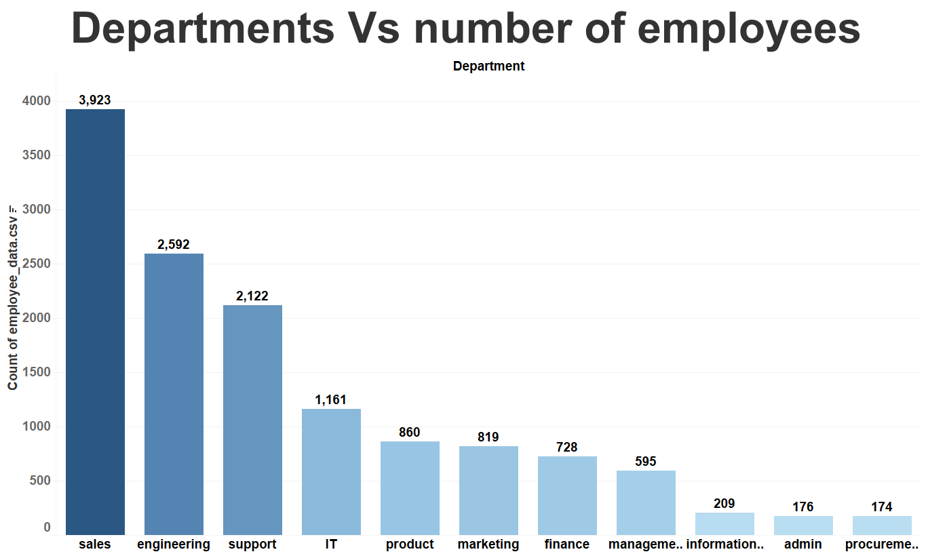

Slide 8
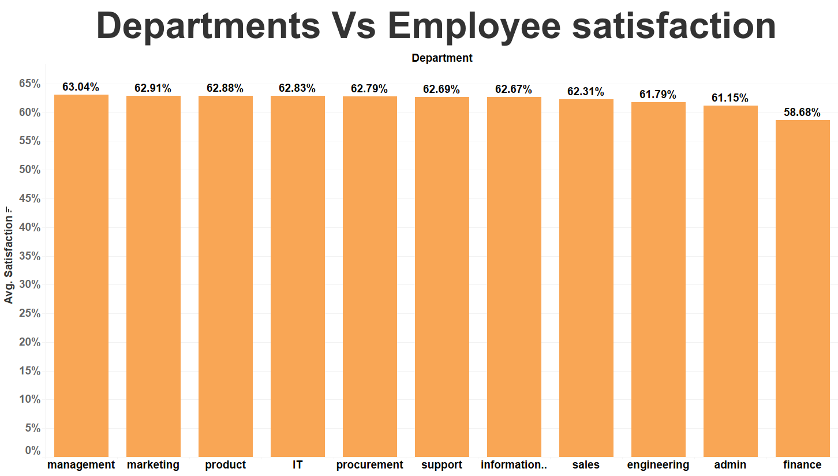

Slide 9
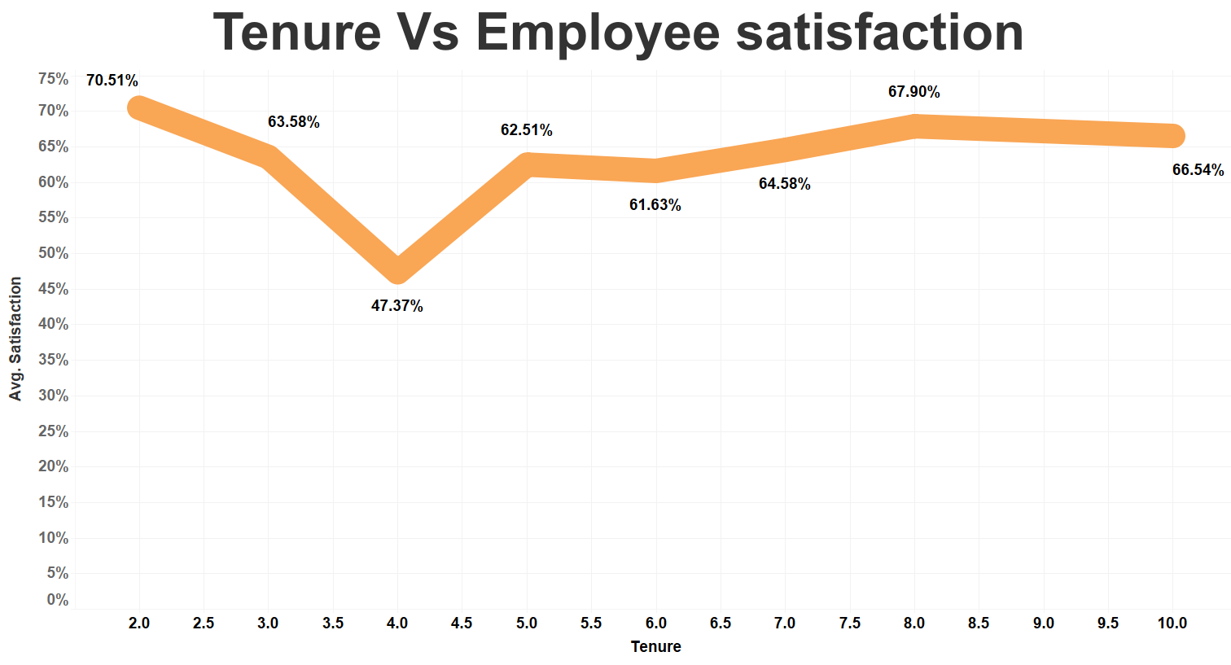
Employee satisfaction is high (70%) in employees with 2 years of tenure, then drops sharply to 47% at 4 years, then rises to 62% at 5 years. After 5 years, it plateaus out.

Slide 10
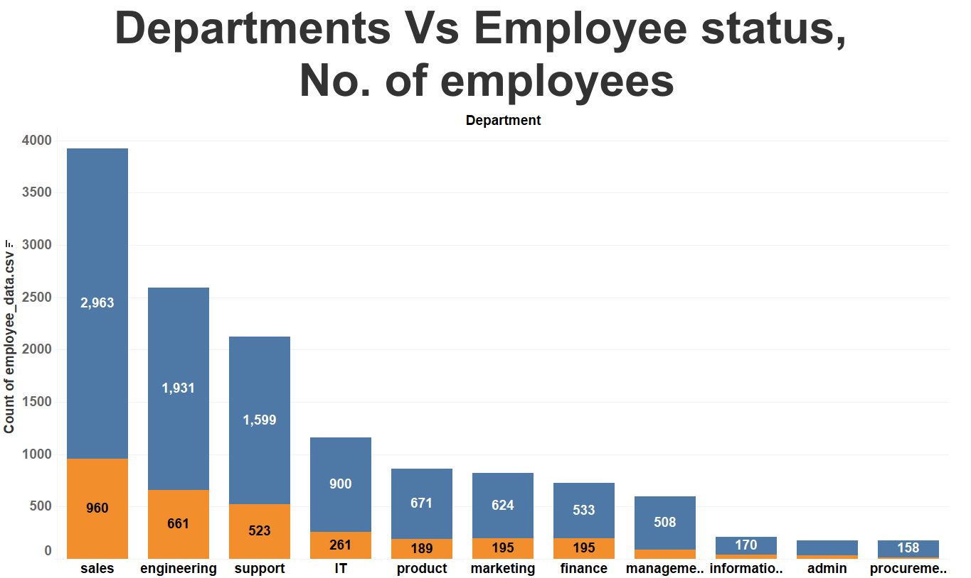
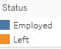
The chart shows, employees employment status in each department, and the number of employees employed/left

Slide 11
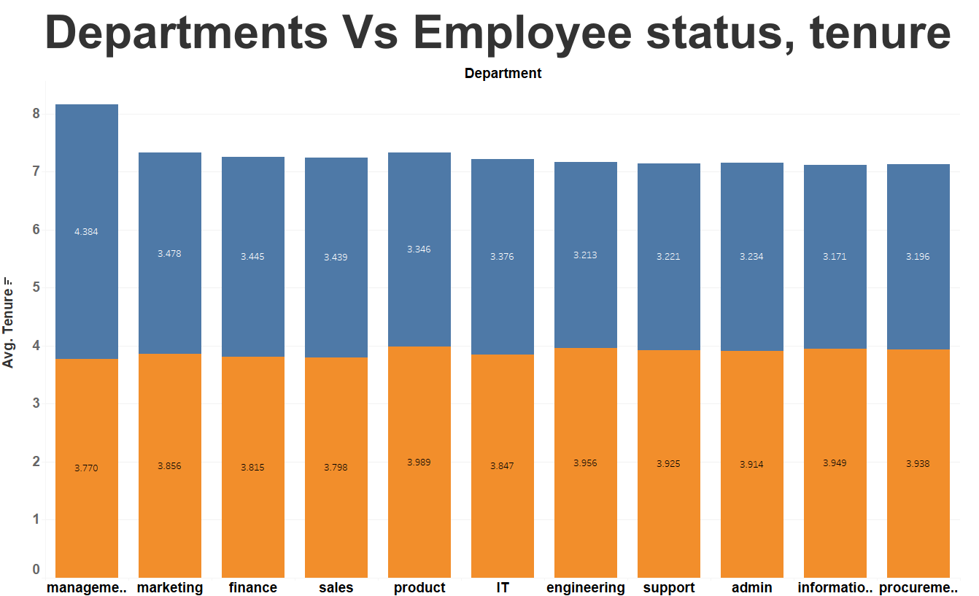
The chart shows, employees employment status in each department, and the average tenure of employees

Slide 12
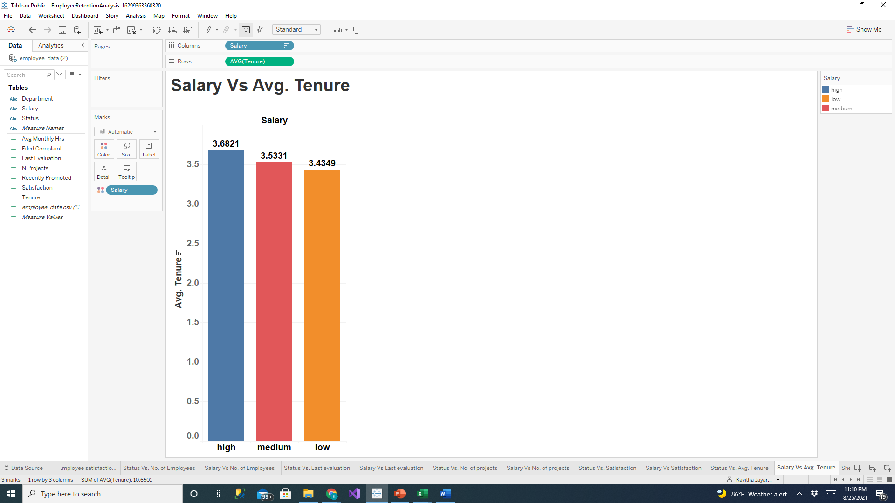
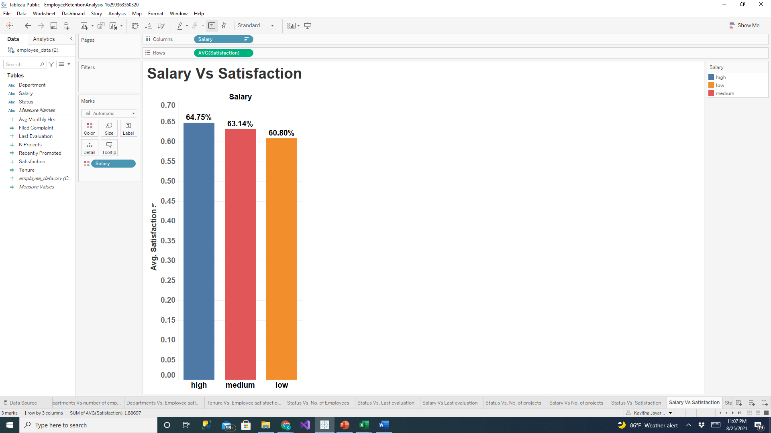
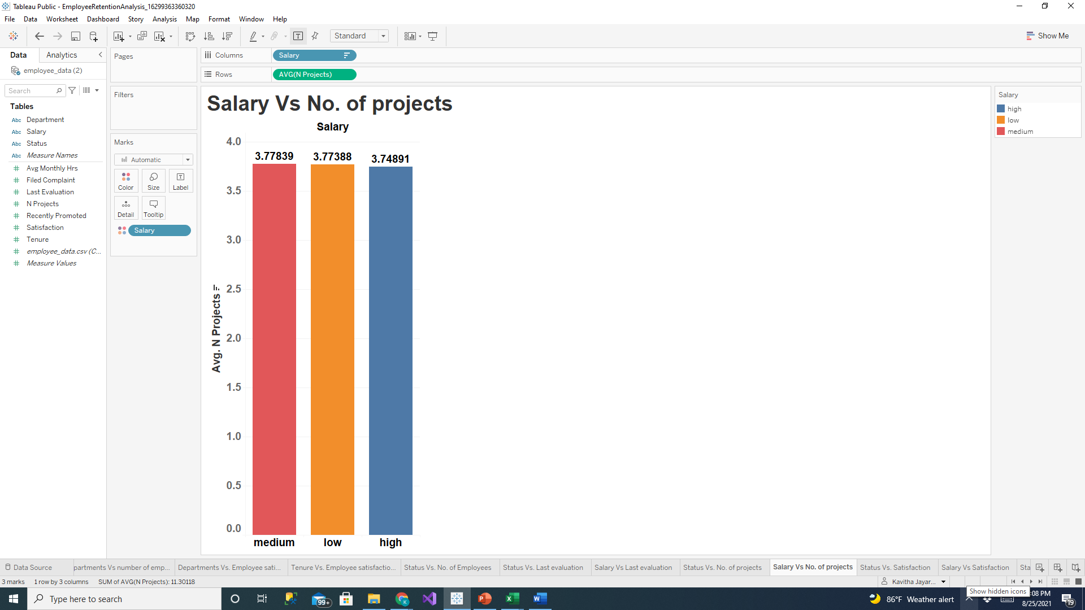
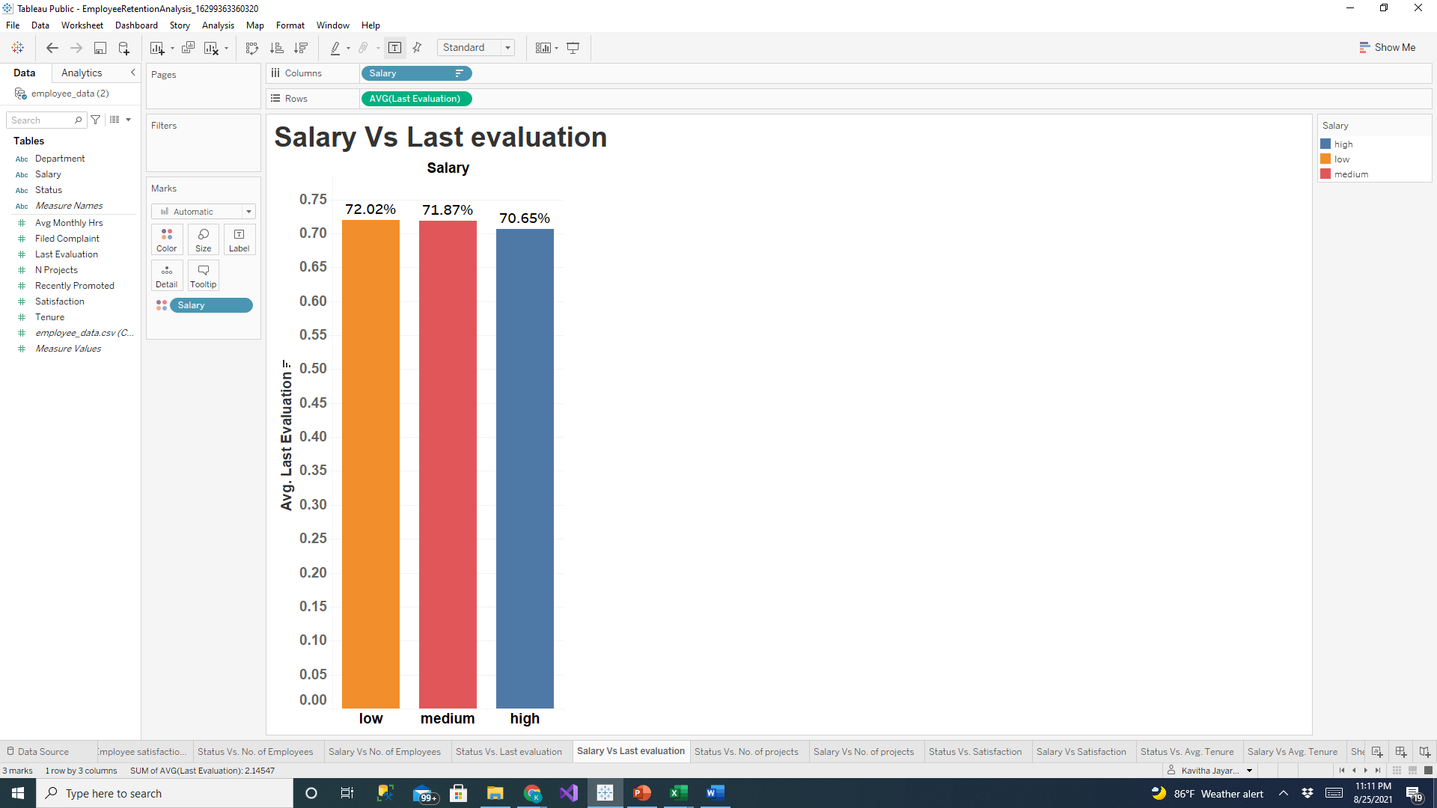
Does Salary affect other features?
Employees with high Salary have high Employee satisfaction and high tenure, but the difference is not significant

Slide 13
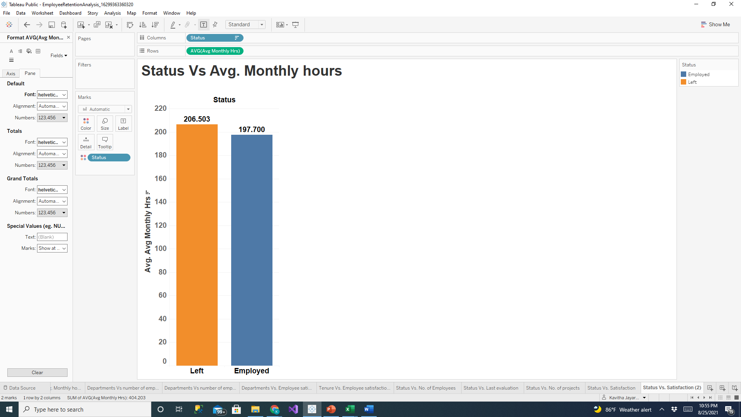
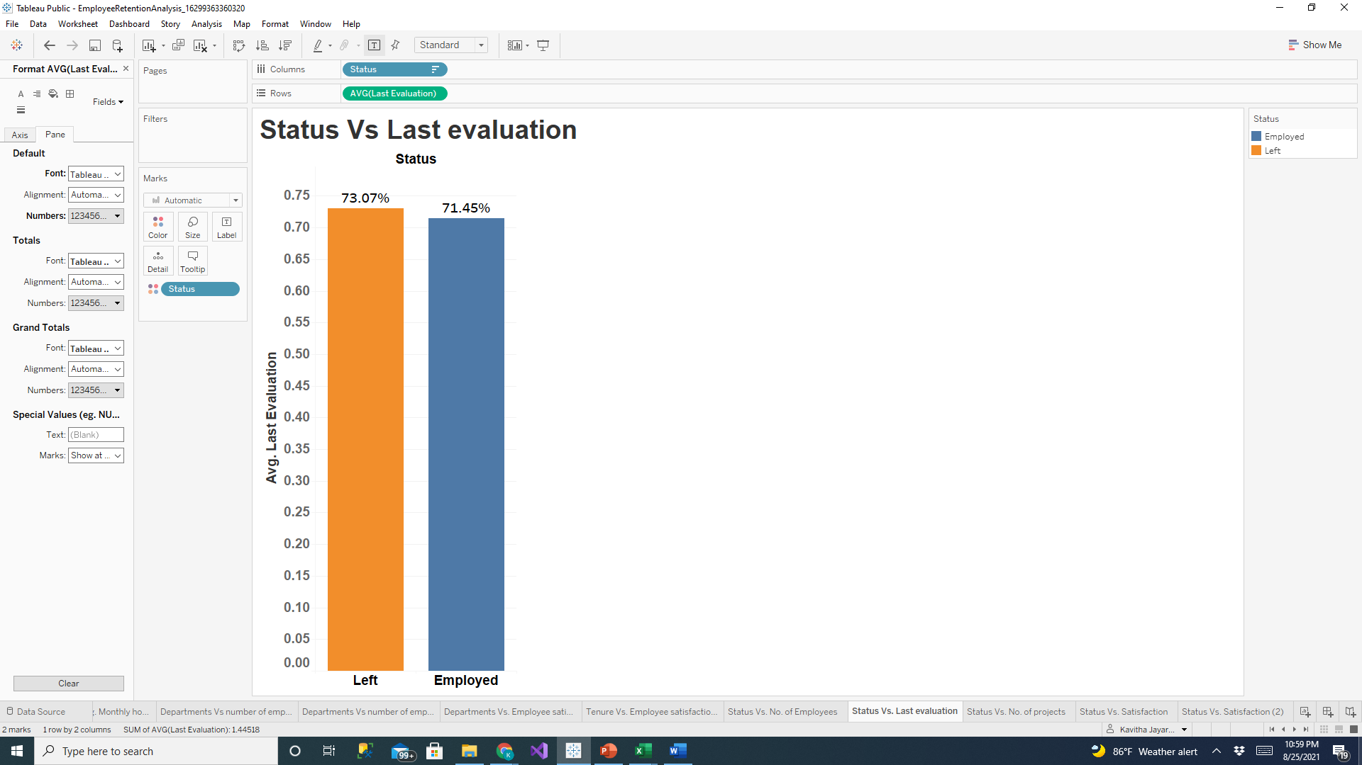

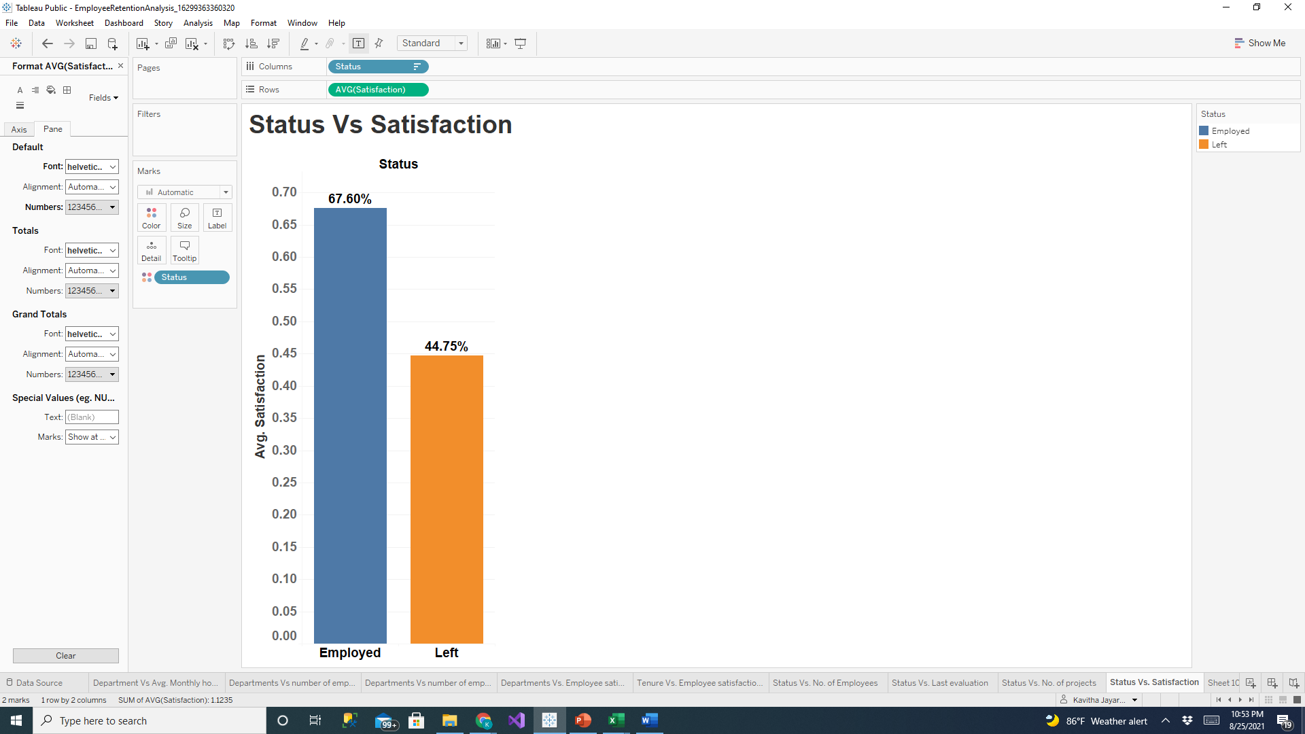
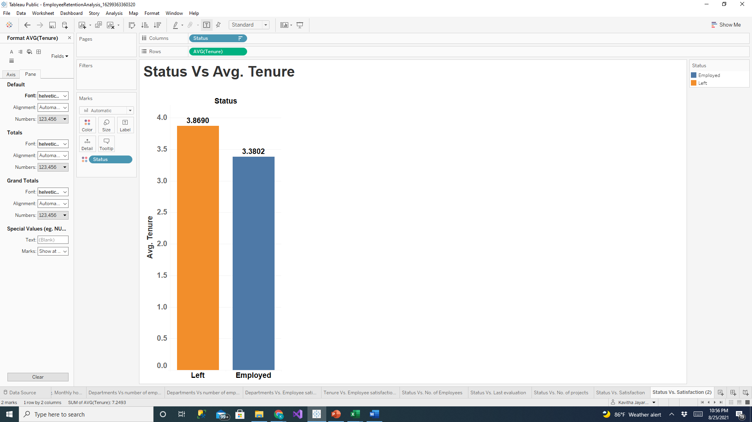
Which feature affects employee retention?
Employee satisfaction is the most impacting feature for Employee retention

Slide 14
Chi-squared test is a statistical method that measures how close expected values are to actual results. Top 5 impacting features on employee retention: Number of projects, Satisfaction, Avg. Monthly hours, Tenure, Last evaluation Bottom 2 impacting features on employee retention: Salary, Department
Chi-Squared Test Analysis
Independent variable | Chi-squared test value
No. of projects | 4664.748952
Satisfaction | 3549.141523
Avg. Monthly hours | 1944.677611
Tenure | 1858.047258
Last evaluation | 1085.765778
Salary | 350.817666
Department | 78.635058

Slide 15
The correlation coefficient R measures the strength and direction of a linear relationship between two variables. The value of R is always between +1 (Strong positive) and –1 (Strong negative). Top 3 features that have strong linear relationship with Employee retention status: Satisfaction, Salary, Tenure All other correlations are weak.
Linear Correlation Tests Analysis
Independent Variable | R (Independent variable, Average Standard Score)
Avg. Monthly hours | -0.073514
Last evaluation | -0.037926
No. of projects | -0.026464
Salary | 0.155516
Satisfaction | 0.3878037
Tenure | -0.1430274

Slide 16
Questions?

